Slide 1


Slide 2


Slide 3

  Download Challenge:
  Install the “You Version Bible” App on your smart phone.
  Got to Menu, select Plans.
  Search and Sign-Up for the “Bible Project NT in a Year” plan!

Slide 4
  Transformation begins with salvation.

Slide 5
  Sanctification: “set apart for God”

Slide 6
  “May God himself, the God of Peace, sanctify you through and through. May your whole spirit, soul and body be kept blameless at the coming of our Lord Jesus Christ. The one who calls you is faithful and he will do it.”
  1 Thessalonians 5:23-24

Slide 7
  You cannot compartmentalize your relationship with God.

Slide 8

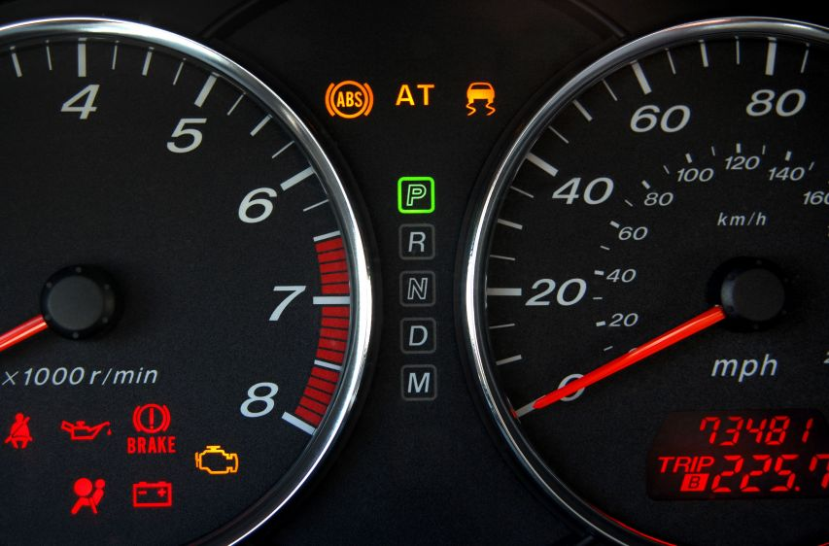
  Photo: https://www.firsttireandauto.com/blog/how-to-understand-your-check-engine-light

Slide 9
  “Elijah was a man just like us. He prayed earnestly that it would not rain, and it did not rain on the land for three and a half years.”
  James 5:17

Slide 10
  “Now Ahab told Jezebel everything Elijah had done and how he had killed all the prophets with the sword . . .

Slide 11
  . . . So Jezebel sent a messenger to Elijah to say, “May the gods deal with me, be it ever so severely, if by this time tomorrow I do not make your life like that of one of them.”
  1 Kings 19:1-2

Slide 12
  “Elijah was afraid and ran for his life . . .”
  1 Kings 19:3

Slide 13
  “. . . He came to a broom tree, sat down under it and prayed that he might die. ‘I have had enough, LORD,’ he said. ‘Take my life; I am no better than my ancestors.’”
  1 Kings 19:4

Slide 14
  “The he lay down under the tree and fell asleep. All at once an angel touched him and said, ‘Get up and eat.’”
  1 Kings 19:5

Slide 15
  “There he went into a cave and spent the night. And the word of the LORD came to him: ‘What are you doing here, Elijah?’” . . .

Slide 16
  "He replied, ‘I have been very zealous for the LORD God Almighty. The Israelites have rejected your covenant, broken down your altars, and put your prophets to death with the sword. I am the only one left, and now they are trying to kill me too.’” . . .

Slide 17
  “The LORD said, ‘Go out and stand on the mountain in the presence of the LORD, for the LORD is about to pass by.’ Then a great and powerful wind tore the mountains apart and shattered the rocks before the LORD, but the LORD was not in the wind. After the wind there was an earthquake, but the LORD was not in the earthquake.” . . .

Slide 18
  “After the earthquake came a fire, but the LORD was not in the fire. And after the fire came a gentle whisper.”
  1 Kings 19:9-12

Slide 19
  “When Elijah heard it, he pulled his cloak over his face and went out and stood at the mouth of the cave. Then a voice said to him, ‘What are you doing here, Elijah?’”
  1 Kings 19:13

Slide 20
  We won’t be able to receive new instructions until we process out fears!

Slide 21
  “Yet I reserve seven thousand in Israel — all whose knees have not bowed down to Baal and all whose mouths have not kissed him.”
  1 Kings 19:18

Slide 22
